Slide 1
IT 1107 Mathematics for IT
Week 5 - Relations

Slide 2
Representation of relations on finite sets
There are 3 ways of picturing a relation R from A to B
Arrow Diagram
Matrix
Directed Graph

Slide 3
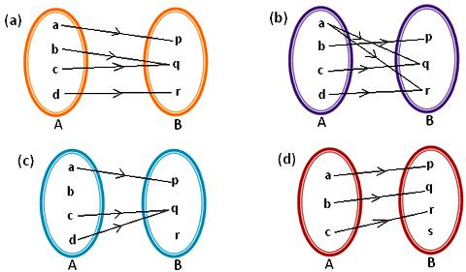
Arrow Diagram
Eg: Let A={a,b,c,d} and B={p,q,r}
R= {(a,p),(b,q),(c,q),(d,r)}

Slide 4
Matrix
Eg: Let A={a,b,c,d} and B={p,q,r}
R= {(a,p),(b,q),(c,q),(d,r)}
p q r
a 1 0 0
b 0 1 0
c 0 1 0
d 0 0 1

Slide 5
Directed Graph
There is another way of picturing a relation R when R is a relation from a finite set A to itself
Eg: Let A={1,2,3,4}
R={(1,2),(2,2),(2,4),(3,2),(3,4),(4,1),(4,3)}
1
2
3
4

Slide 6
Composition of relations
Let A,B,C be sets and let R be a relation from A to B. let S be a relation from B to C. then R and S give rise to a relation from A to C denoted by RoS and defined as follows
RoS={(a,c): there exists b∈B for which (a,b) ∈R and (b,c) ∈ S}
This relation RoS is called the composition of R and S (Ref:Descrete Mathematics 3rd Ed Schamu’s series pg 27)

Slide 7
Eg: Let A={1,2,3,4} , B={a,b,c,d} and C={x,y,z}
R={(1,a),(2,d),(3,a),(3,b),(3,d)}
S={(b,x),(b,z),(c,y),(d,z)}
RoS={(3,x),(3,z),(2,z)}
A B C
1
2
3
4
a
b
c
d
x
y
z

Slide 8
If R is a relation on set A then RoR ,the composition of R with itself is always defined & sometimes denoted as R²
Note: Let A,B,C,D be sets. Suppose R is a relation from A to B, S is a relation from B to C, T is a relation from C to D. then
(RoS)oT = Ro(SoT)

Slide 9
Composition of relation and matrices
There’s another way of finding RoS using matrices. Let M_{R} and M_{S} denote the matrices of the relations R & S respectively
M_{RoS} = M_{R}.M_{S}

Slide 10
Eg: A = {1,2,3,4} B = {a,b,c,d} C = {x,y,z}
R ={(1,a),(2,d),(3,a),(3,b),(3,d)}
S={(b,x),(b,z),(c,y),(d,z)}
M_{R} a b c d M_{s} x y z
1 1 0 0 0 a 0 0 0
2 0 0 0 1 b 1 0 1
3 1 1 0 1 c 0 1 0
4 0 0 0 0 d 0 0 1
M_{R}. M_{s} x y z
1 0 0 0
2 0 0 1
3 1 0 2
4 0 0 0

Slide 11
Types of Relations
Reflexive relation
A relation R is said to be reflexive over a set A if (a,a) ∈ R for every a ∈ R.
The relation R = {(1,1)(2,2)(3,3)(1,2)(1,3)} is reflexive over the set A = {1,2,3}.
Symmetric relation
A relation R is said to be symmetric if (a,b) ∈ R => (b,a) ∈ R
The relation R = {(1,2)(2,2)(2,1)} is symmetric over the set A = {1,2,3}.

Slide 12
Anti symmetric relations
for any a, and b in A, whenever (a, b) ∈ R , and (b, a) ∈ R , a = b must hold
The relation R = {(1,3)(2,2)(2,3)} is antisymmetric over the set A = {1,2,3}.
Transitive relation
A relation R is said to be transitive if (a,b) ∈ R, (b,c) ∈ R => (a,c) ∈ R
The relation R = {(1,3)(2,3)(1,2)(1,1)} is transitive over the set A = {1,2,3}.

